Slide 1
Consumers’ Processing of Organic, Natural, and Standard Labeling
Erica Bewley
Daniel Turnbow
Hanover College

Slide 2
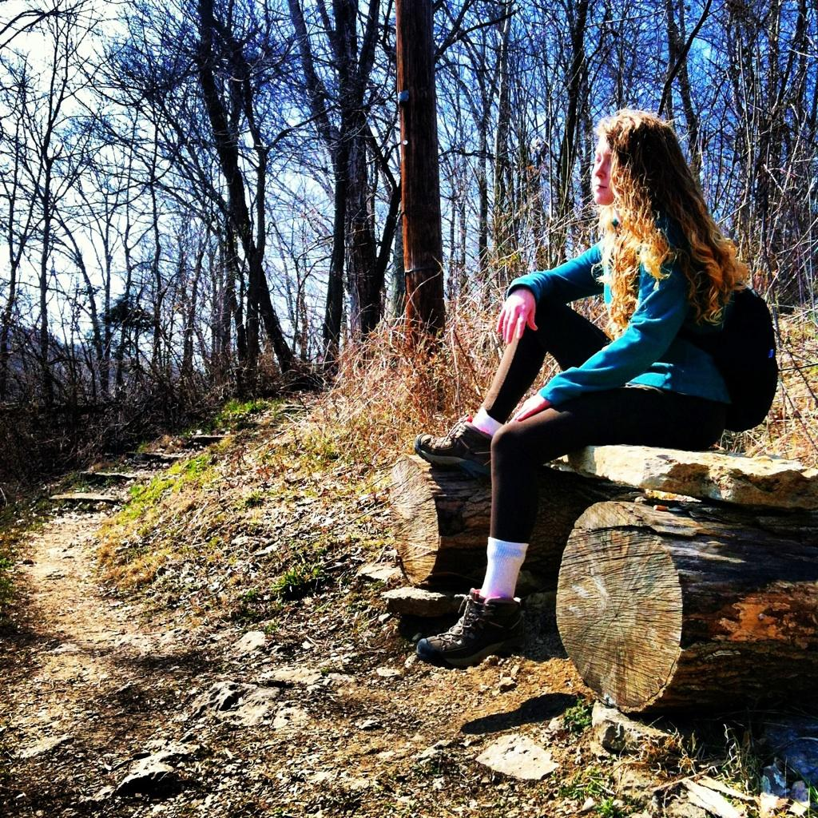

Slide 3
The Growing Organic Market
In 1991 and 1995 only 7 percent of all organic sales were contributed by conventional retailers
In 2000, 49 percent of all organic sales were supplied through conventional retailers
(Dimitri & Greene, 2000)

Slide 4
The Collision of all Packaged Products
(Kuvykaite, Dovaliene and Navickiene, 2009)
http://www.joshuakennon.com

Slide 5
Three classes of products and Packaging
Standard Manufactured
Packaging is based on product
Natural
Packaging has heavy implications of Naturalness.
Organic
Packaging displays organic characteristics and is USDA approved.

Slide 6
Why do we choose the products that we do?
Choices could be attributed to:
Packaging
(Kuvykaite, Dovaliene and Navickiene, 2009)
Eco-labeling
(Johnston, Wessells, donath, and Asche, 2001)
Personal characteristics and opinions
(Sirgy, 1985)

Slide 7
Personal Differences
Organic Products may have a symbolic value on which personality traits can be reflected (Grubb and Grathwohl, 1967)
Moral norms (such as, personal beliefs considering right or wrong doings) can be deemed the main motivator of purchasing intention.
(Guido, Prete, Peluso, Maloumby-Baka, and Buffa, 2010)
When considering Organic vs. Standard products individual personality traits may indicate a relationship with consumer behavior.

Slide 8
Idealism
High Idealism: Desired consequences can be brought about through the “right” actions.
Low Idealism: Desired and undesired consequences come as a mixed bag and you can’t know why something happens.
Schlenker & Forsyth, 1977

Slide 9
Hypothesis
People will be willing to pay more for organic products
Personal characteristics will play a role in the choosing of certain products

Slide 10
Participants
N= 169
Gender
Females: 99
Males: 70
Age
Mean:25.9
Median: 22
Range: 15 - 64
Online survey participants
Education level
Median ranged between a high school education and some college experience
SES
Median income bracket:
$25,000-$50,000

Slide 11
Stimuli
Three product classes from each of three companies
Companies were selected for having a product that appears in each of our three categories
Though Smucker's did have an organic grape jelly, it was unobtainable in our area.
An organic granola bar was substituted in its place
Unable to find similar flavors and color of the R.W. Knudsen juice in all three classes as well

Slide 12
Standard

Slide 13
Natural

Slide 14
Organic

Slide 15
Equipment
Online Survey
Photos of Products
DSLR Camera
Actual products
Borrow Photo lab in CFA
Notes:
Model of dslr

Slide 16
Design
Mixed design
Each participant views only one product category. e.g. only organic products
Online survey

Slide 17
Procedure
With product displayed, asked to make judgments about the product one factor at a time
Free Short response for price willing to pay
Quality, environmental friendliness, healthfulness, ethicalness of company
Asked to complete demographic section
Personality
Idealism
(Forsyth, 1980)
Big five
(Gosling, 2003)

Slide 18
Product Features

Slide 19
Price Willing to pay

Slide 20
Discussion
People were not willing to pay more for organic products
High ratings in organic for quaility, environment, healthiness, and ethical
Personality Dimensions
Idealism:
Highly idealistic = willing to pay more for organic, but not natural products
Low Idealism = natural products

Slide 21
Future Research
Within-Subjects Design
Forced choice
Familiartiy of product
Expanded Big Five

Slide 22
Questions
???????????

Slide 23
Ethicalness of company and Participant Agreeableness

Slide 24
Quality of product and Participant Agreeableness

Slide 25
Ethicalness and Idealism

Slide 26
Healthfulness of product and Participant Agreeableness

